Slide 1
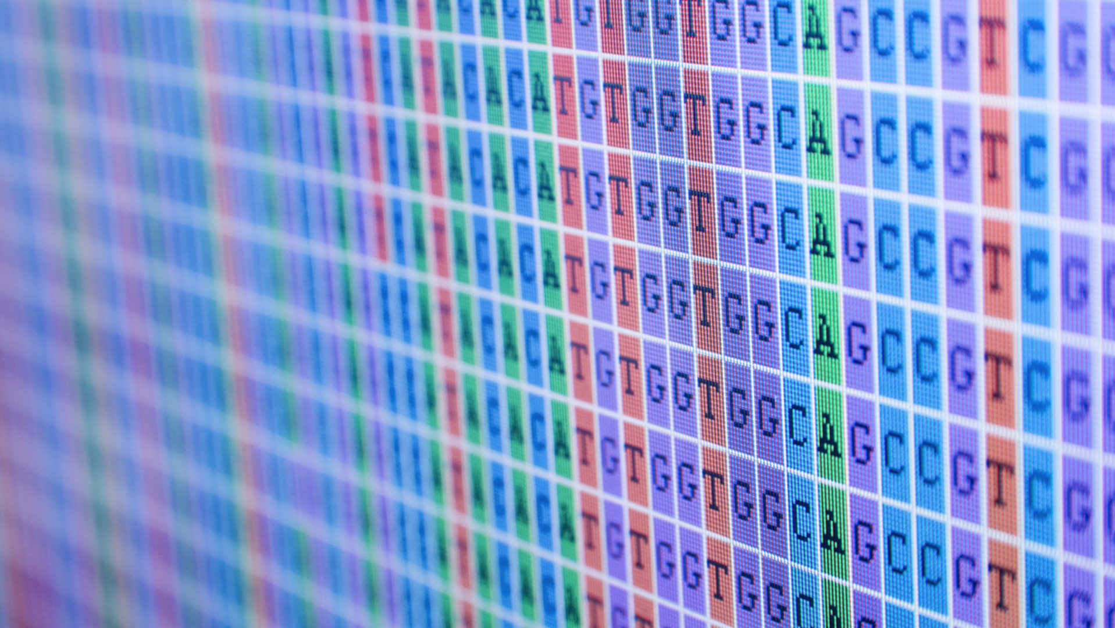
Sequencing technology and the Human Genome Project
Konrad Karczewski
Adapted from Elizabeth Atkinson

Slide 2
SNP Microarrays
Suffers ascertainment bias
Especially bad for understudied populations

Slide 3
Next generation sequencing
First human genome (Human Genome Project)
Took 13 years to complete (in 2003)
Cost $3 billion
Now, with NGS, whole human genome can be sequenced in a single day for a few hundred $
MUCH cheaper to do
High-throughput – massively parallel technology
Takes advantage of bioinformatics
Notes:
NGS was a Major breakthrough in DNA sequencing technology

Slide 4
Introduction of NGS
Notes:
"Moore's law" is the observation that the number of transistors in a dense integrated circuit has doubled approximately every two years.
Basically, that technology is following an exponential rate of increase. And the NGS breakthrough deviated from that exponential increase itself exponentially.

Slide 5
Next generation sequencing
Illumina is currently the main company that sell sequencing equipment
Watch Illumina explanation of how the technology works:
https://youtu.be/womKfikWlxM

Slide 6
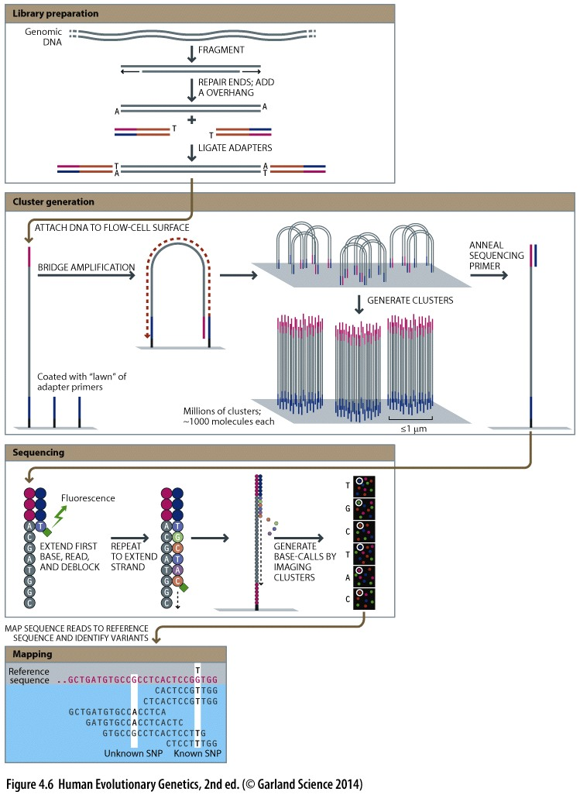
Next gen sequencing
Shear / fragment your DNA into tiny bits
Repair ends and add overhang SNP
Ligate adaptors (and barcodes)
Denature the DNA and then adaptors attach to the flow-cell
Synthesize DNA and wash away original template
Bridge amplification, other end of the adaptor attaches to the flow cell to form a bridge.
Hybridized primer extended by polymerases created a double stranded bridge

Slide 7
Detach 5’ end, de-nature DNA and repeat bridge amplification until you have a cluster of identical DNA templates
Reverse strands are cleaved washed away – leaving only the forward strand
Why?
Process can be repeated for the reverse strands
Add sequencing primer and fluorescent NTPs
Tiny camera captures the fluorescing clusters in real time as the NTPs are added – typically about 35-125 base pairs
Output are the forward and reverse sequences for short reads.

Slide 8
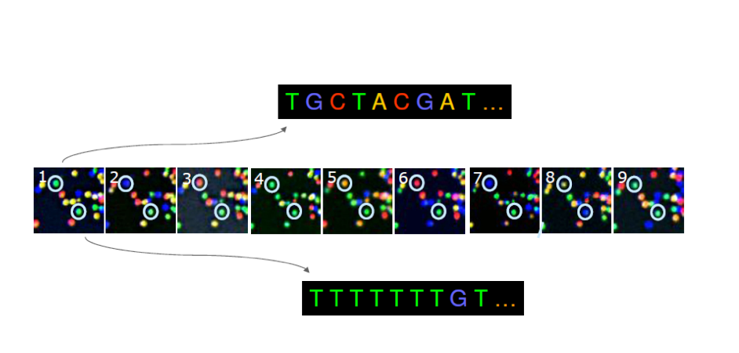
Real time base calling
Notes:
Use bioinformatics to call bases in real time by tracking the flourescent illuminations from the same location/cluster on the flow cell.
Calling by the wavelengths of light perceived by a tiny camera looking at the flow cell. Sometimes there is discrepancy about what color light the camera sees. For this reason, NGS has quite a high error rate.

Slide 9
Calling SNPs from short reads

Slide 10
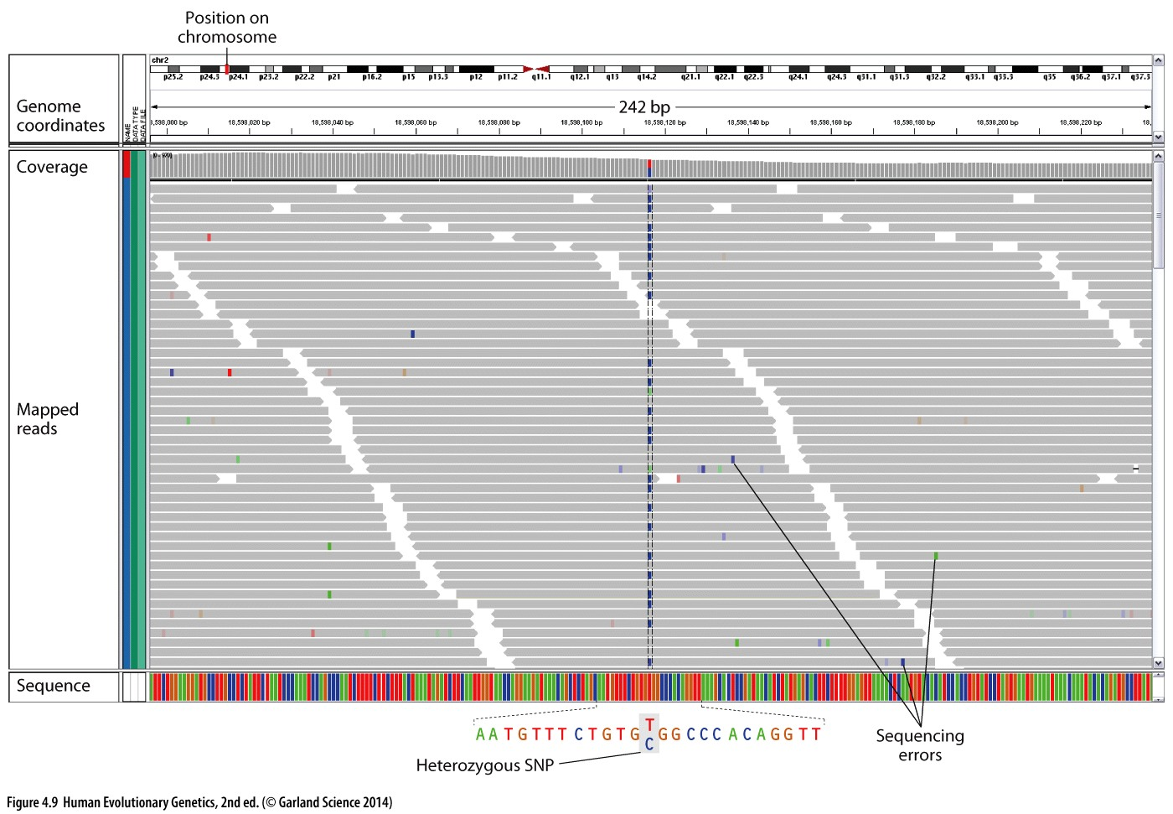
NGS data
Notes:
Reads are mapped to the human reference genome.
Coverage is the average number of basepairs contributing to a call. How many times any given basepair was sequenced. Also called depth.
Why do you want a higher coverage?
~to get around sequencing error.
If only had 1 sequence, 1x coverage, can’t tell if something is a SNP or sequencing error.

Slide 11
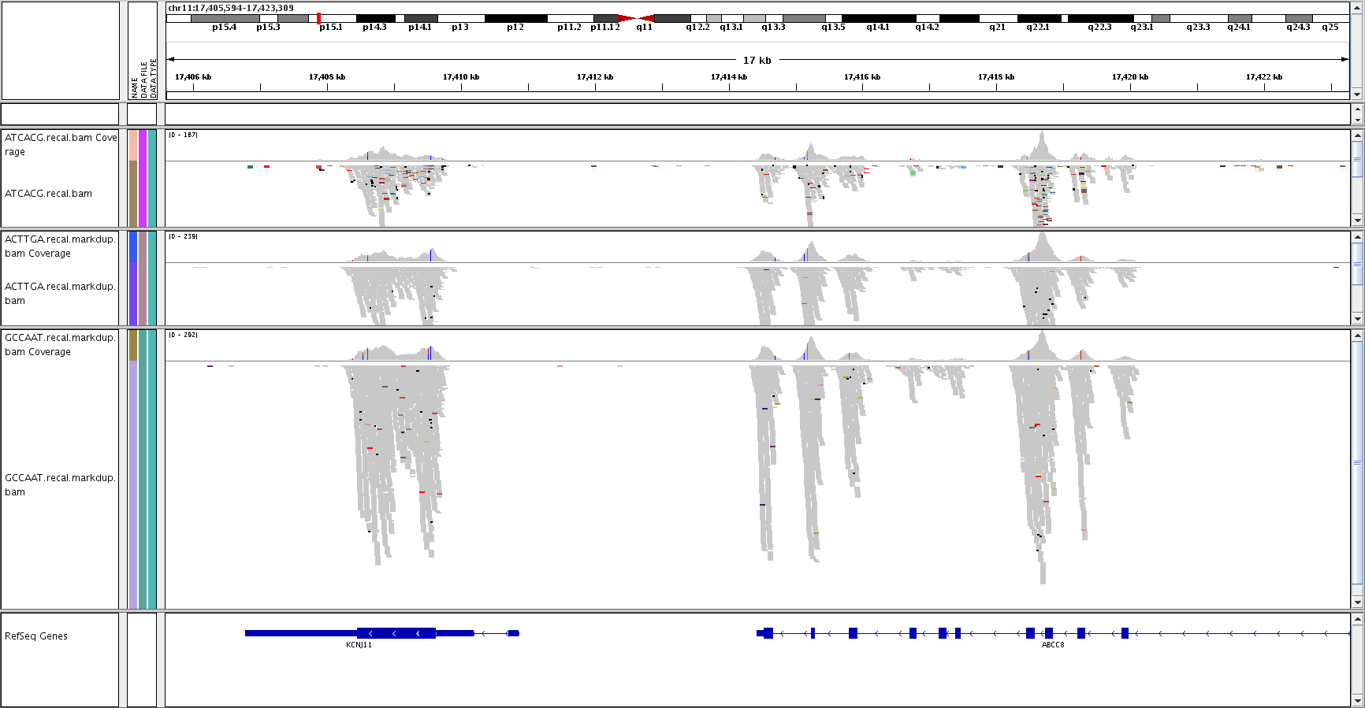
Anyone know what this is?
Notes:
another exome dataset since reads are all piled up over the exons.

Slide 13
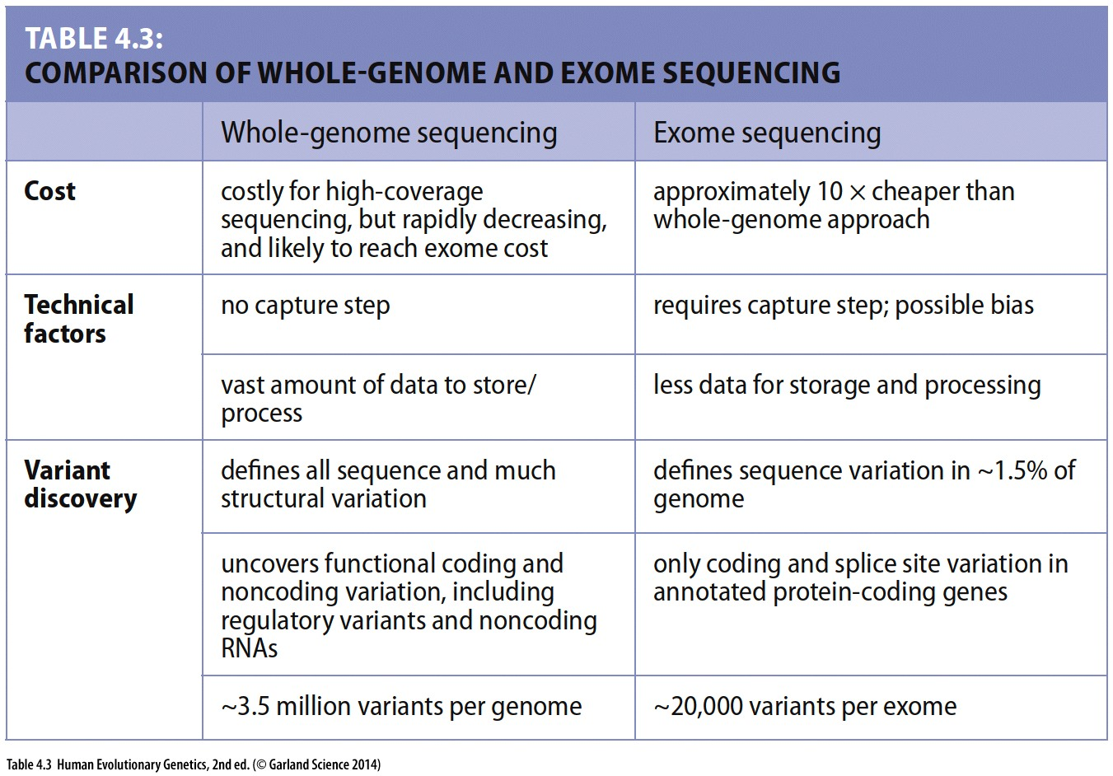
/
3x

Slide 14
Technology improvements -> more data

Slide 15
Human Variation
In human beings, 99.9 percent bases are same.
Remaining 0.1 percent (~3M bases) makes a person unique.
Different attributes / characteristics / traits
how a person looks,
diseases he or she develops.
These variations can be:
Harmless (change in phenotype)
Harmful (diabetes, cancer, heart disease, Huntington's disease, and hemophilia)
Latent (variations found in coding and regulatory regions, are not harmful on their own, and the change in each gene only becomes apparent under certain conditions e.g. susceptibility to lung cancer)
Occasionally beneficial (PCSK9 knockouts have lower cholesterol)

Slide 16
Thanks!

